Slide 1
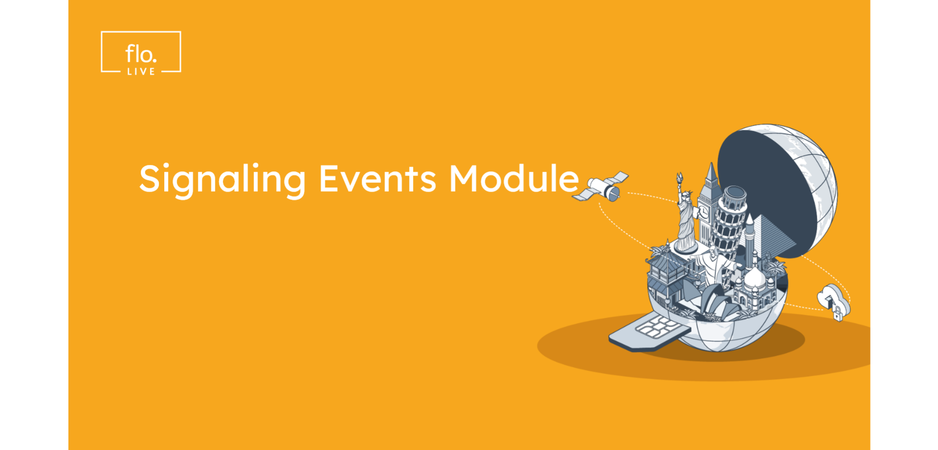
Notes:
Welcome to another Video tutorial from floLIVE.
This Video will focus on floLIVE Connectivity Management Platform Signaling Events module principles.

Slide 2
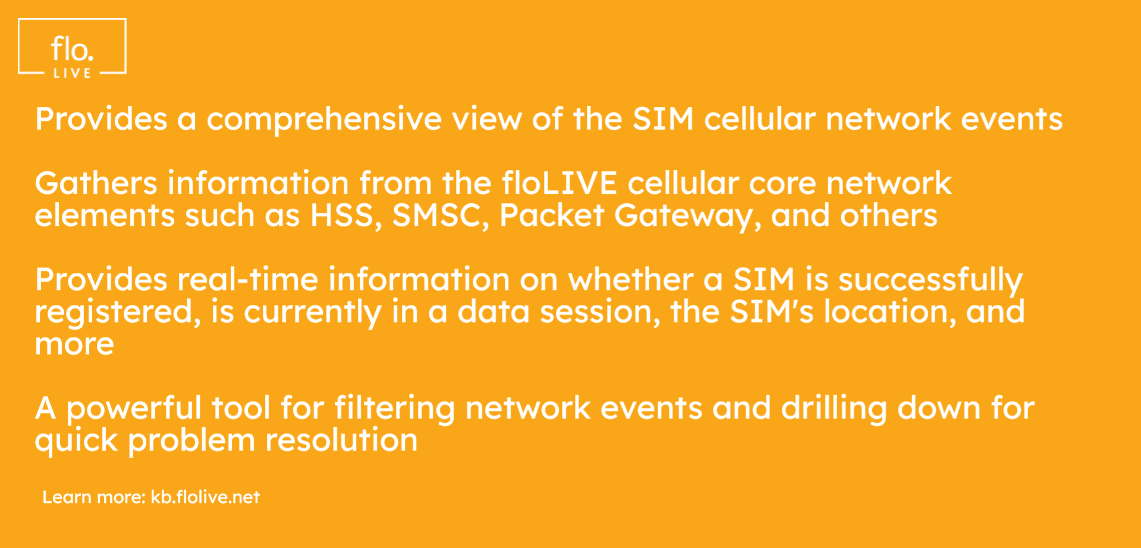
Notes:
The signaling events module provides a comprehensive view of the SIM cellular network events.
This module gathers information from various elements within the floLIVE cellular core network, including the HSS, SMSC, Packet Gateway and mor.
The Signaling Events module provides real-time information on whether a SIM is successfully registered
is currently in a data session
the SIMs location
and more.
The Signaling Events module allows for efficient network event filtering and quicker problem resolution.

Slide 3
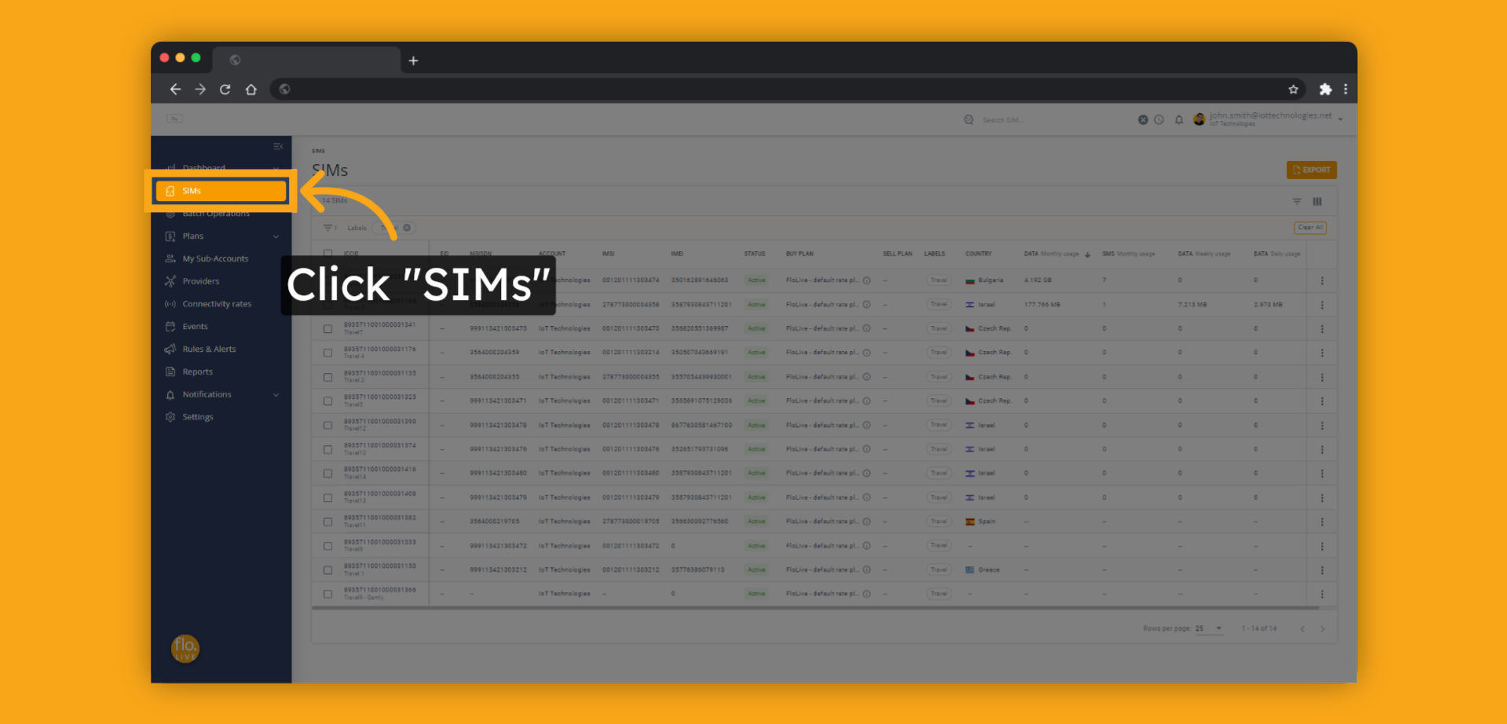
Notes:
To get started, click SIMs.

Slide 4
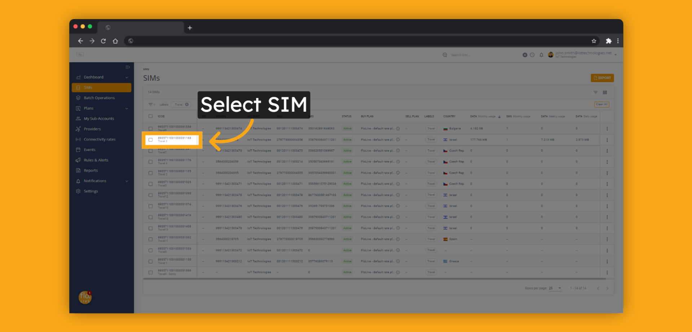
Notes:
Click on a specific SIM

Slide 5
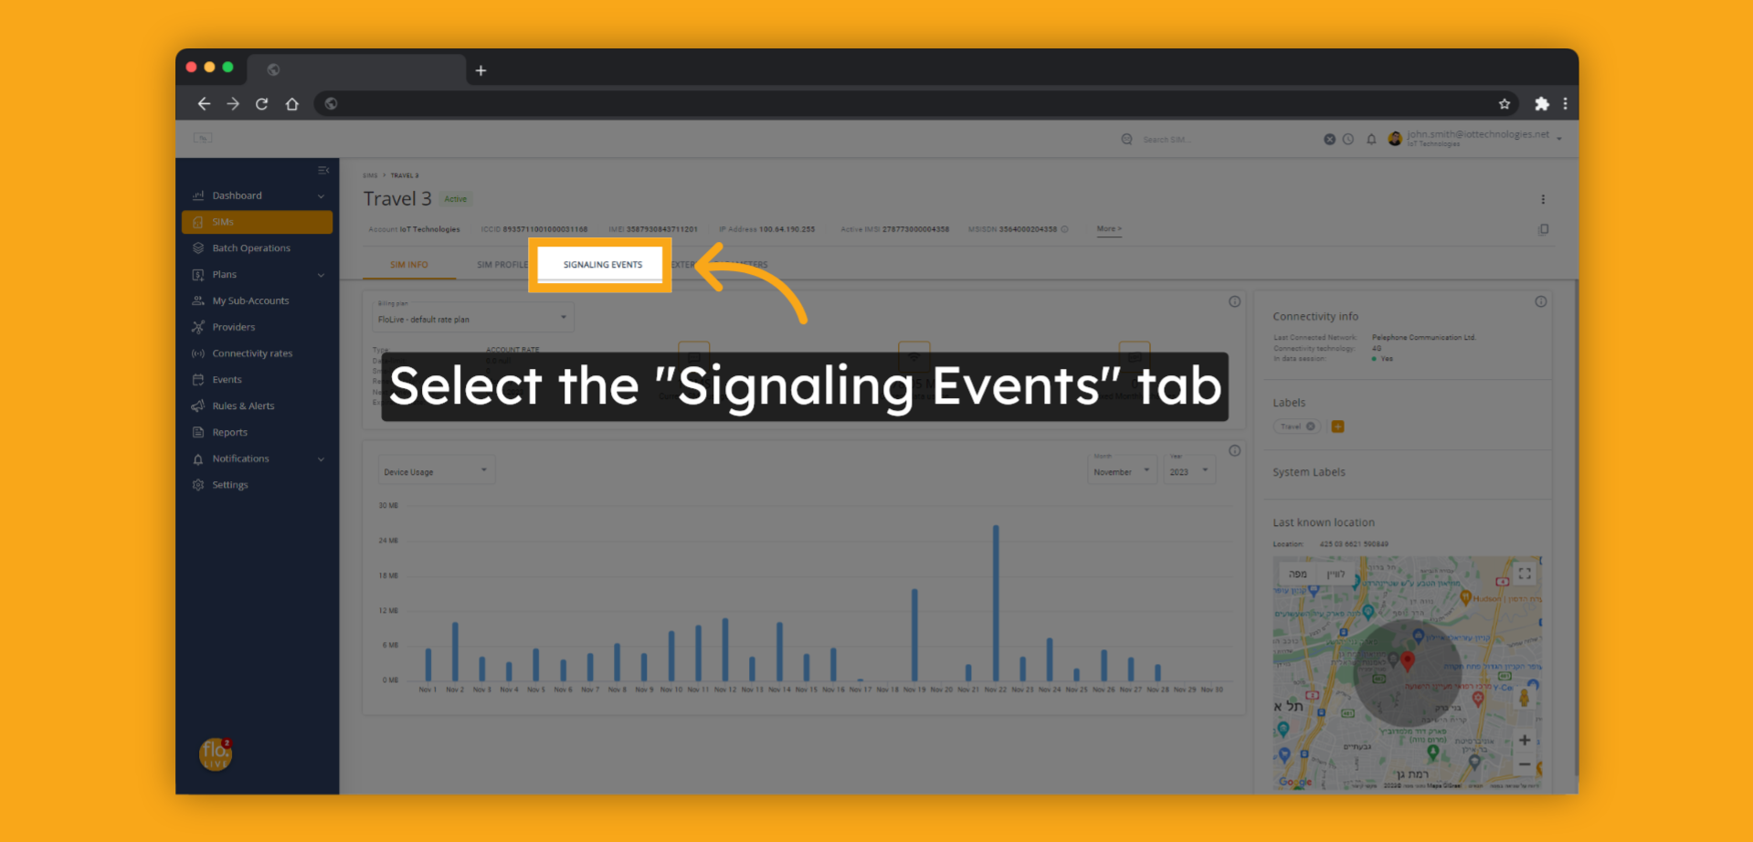
Notes:
Click the Signaling Events tab

Slide 6
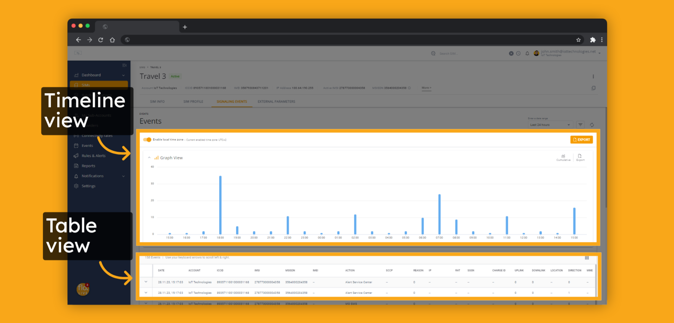
Notes:
The Signaling events page displays events in both timeline and table formats.
The timeline view displays the activity trends of SIM network activity for a chosen period of time.
The events table displays events in a sequential order along with their associated attributes, such as event action, identifiers, session attributes, and more.

Slide 7
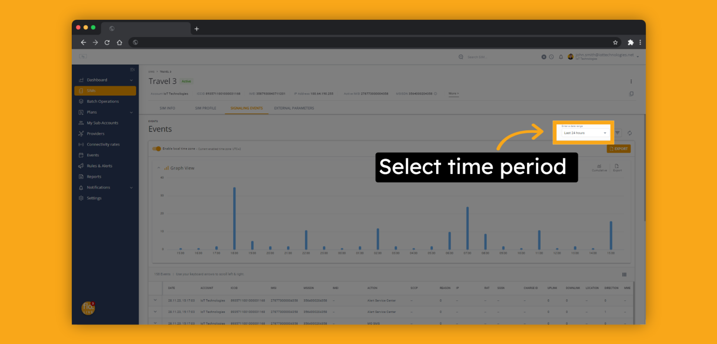
Notes:
Use the time selection to select the desired time period

Slide 8
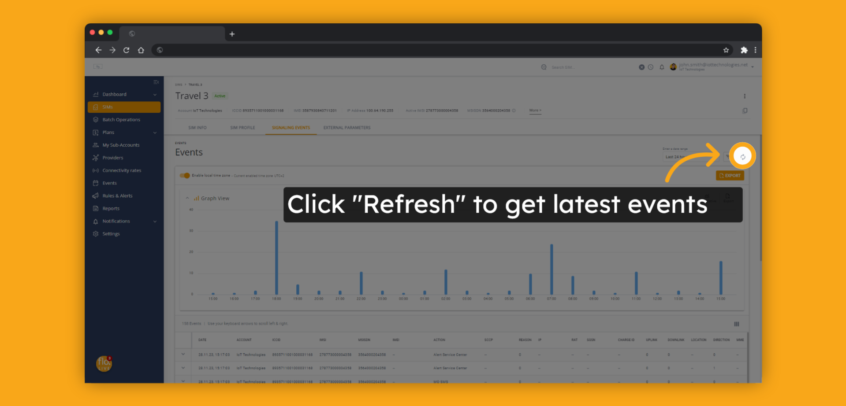
Notes:
You can use the Refresh button to get the latest generated events

Slide 9
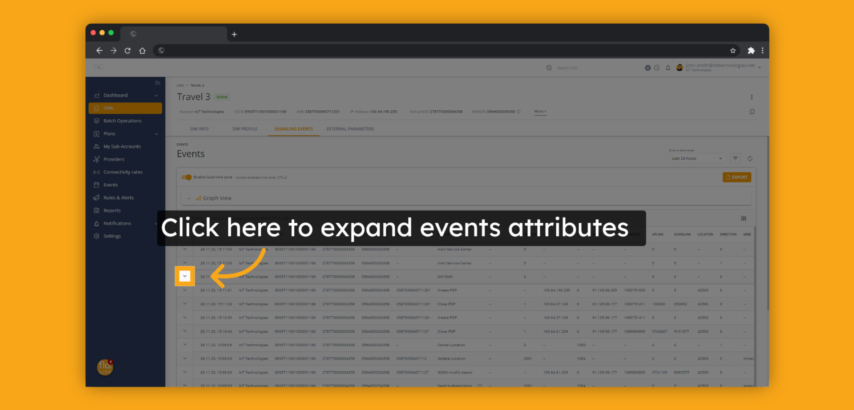
Notes:
To view all the details of an event's attributes, click on the Expand button.

Slide 10
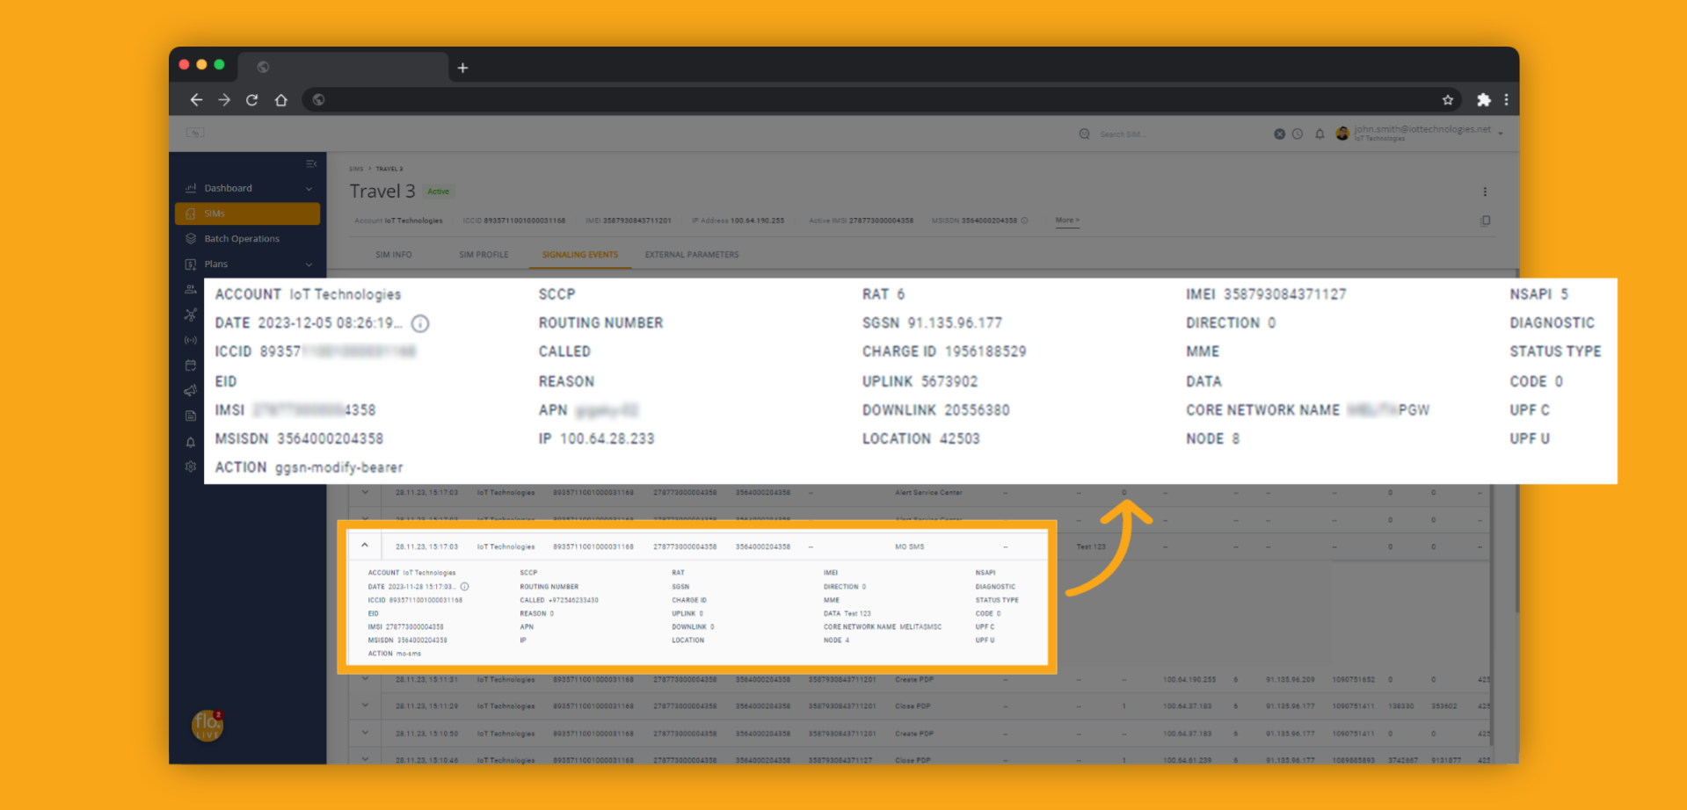
Notes:
Here are the event attributes that are useful for session analysis and troubleshooting.
These include the APN used,
radio access technology,
exchanged data size,
error code in case of failure
and more.
The Events attributes can also contain the payload of SMS messages, making it easier to interact with the device.

Slide 11
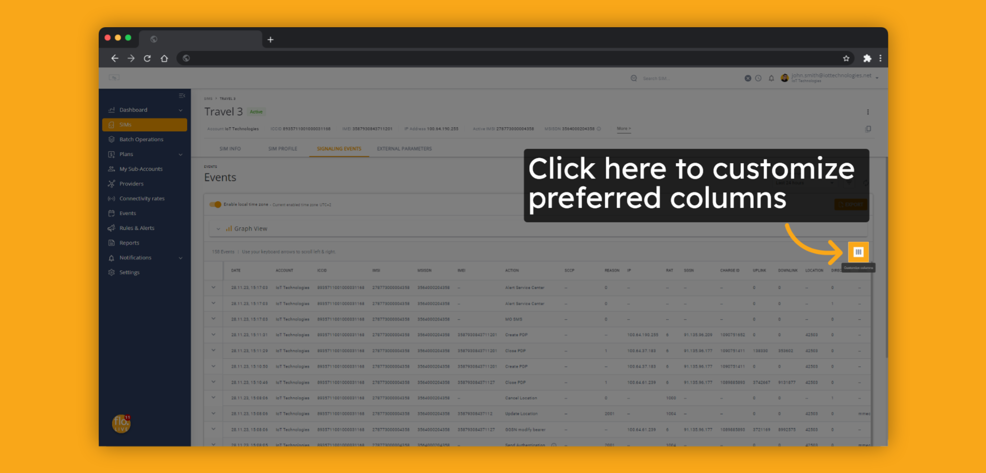
Notes:
The Signaling Events table is highly customizable to the user's preferences.
Clicking on the Customize column button will bring up the Customize Columns menu.

Slide 12
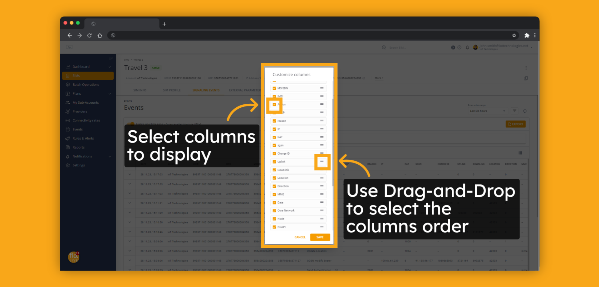
Notes:
Columns can be shown or hidden by using the check uncheck settings box, and their order of appearance can be altered by using the drag-and-drop method.

Slide 13
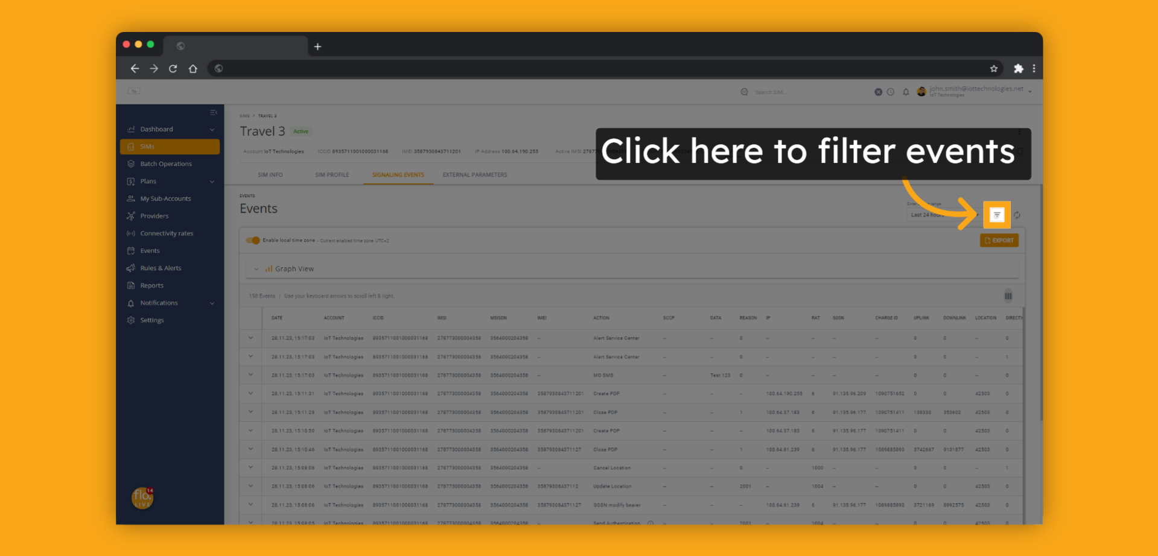
Notes:
For efficient management of large numbers of events, the Signaling Events module offers advanced and flexible filtering capabilities.
Click the filter button to filter the SIMs events.

Slide 14
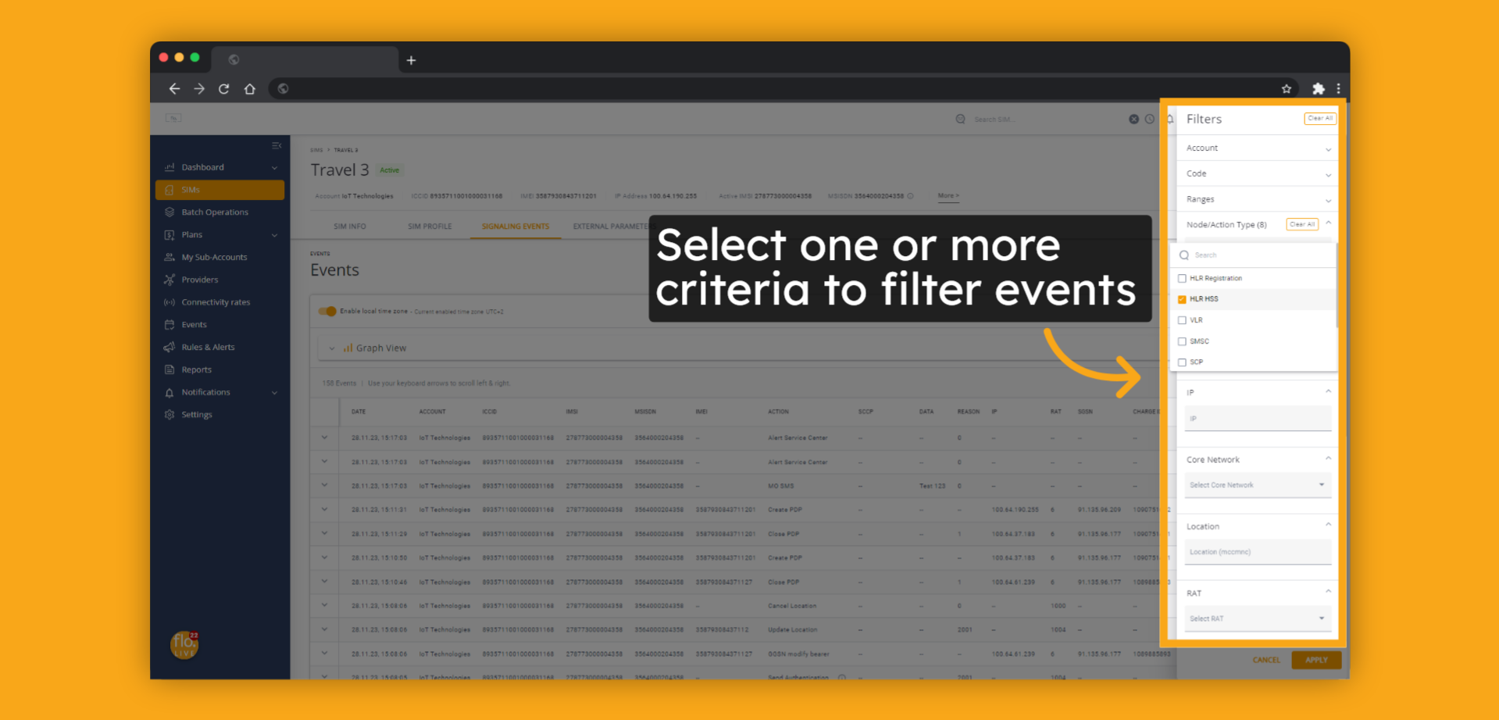
Notes:
You can filter events by one or more signaling event attributes, such as action type, error code, location and more.

Slide 15
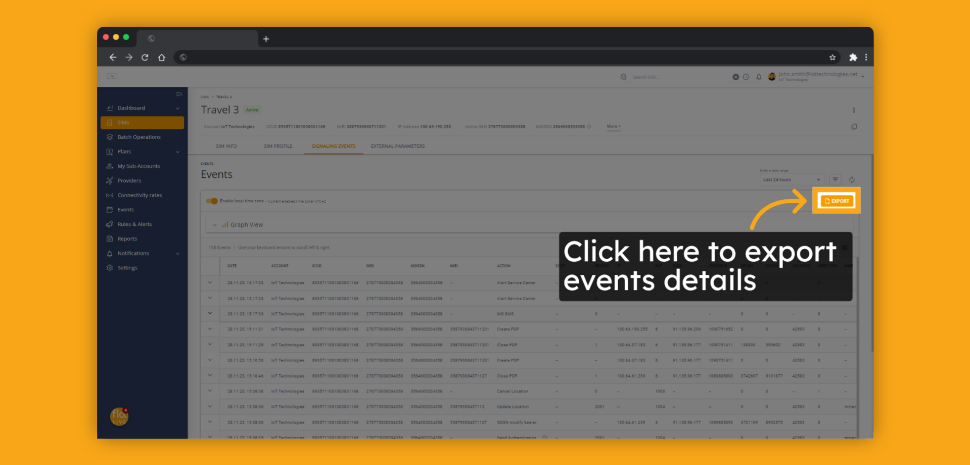
Notes:
Clicking on the Export button allows exporting the displayed signaling events with all their attributes to a CSV file.

Slide 16
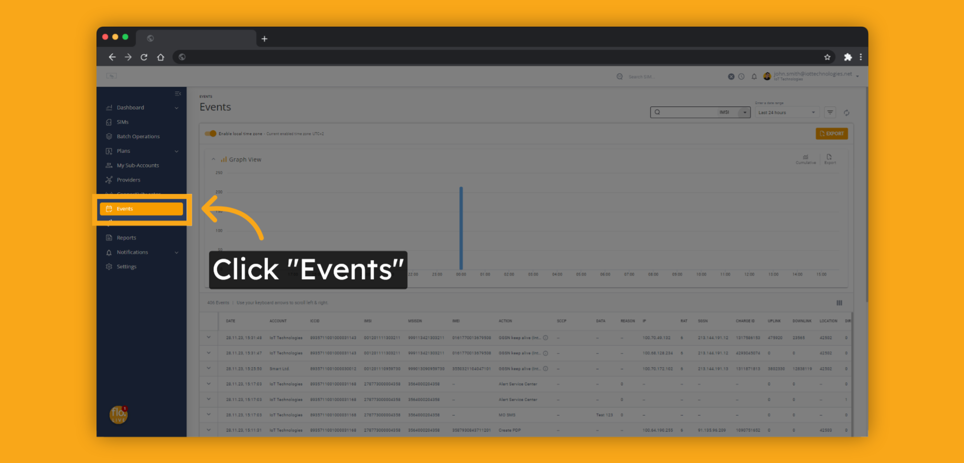
Notes:
The Signaling events module is also available on an account level view.
In this mode you can see signaling events generated by all your SIMs.
To view all events related to the SIMs on your account, click on the Events in the menu.

Slide 17
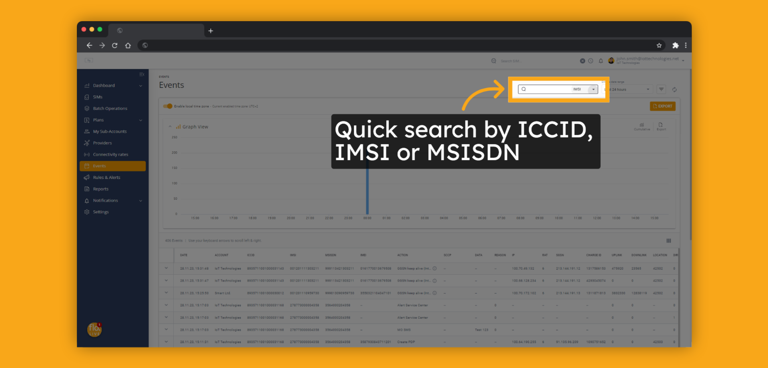
Notes:
You can use the search bar for quickly filter SIM by any of the SIMs identities like ICCID, or IMSI.

Slide 18

Notes:
Thank you for watching this video, we hope it was helpful.
To learn more about the Signaling Events module, visit our floLIVE knowledge center at kb.floLIVE.net.
Join us for additional floLIVE video tutorials available on the floLIVE channel.

